Slide 1
Examination Timetabling Automation using Hybrid Meta-heuristics
Made by: Supervisors:
• Miguel Nunes • Nuno Leite
• Artur Ferreira

Slide 2
Index
Introduction
Educational Timetabling problems
Objectives
Timetabling problem
Types of approaches
ITC2007 Examination timetabling problem
System architecture
Loader e solution initialization
Loader
Graph Coloring
Proposed approach: Local Search
Simulated Annealing
Hill Climbing
Neighborhood Operators
Results

Slide 3
Introduction
Educational Timetabling problems:
Examination Timetabling;
Course Timetabling;
School Timetabling.
Each type of problem must follow different types of constraints:
Hard constraints;
Soft constraints.

Slide 4
Introduction
The main objectives of this project are:
Automated generation of examination timetables, considering the International Timetabling Competition 2007 specifications;
Validation of a timetable provided by the user;
Graphical User Interface to allow the user to check the final generated solution.

Slide 5
Timetabling problem
The timetabling problem may be formulated as multiple types of problems:
Search problem;
Optimization problem.
When solving timetabling problems, it is possible to generate one of multiple types of solutions:
Feasible;
Non feasible;
Optimal;
Sub-optimal.

Slide 6
Types of approaches
There are plenty of types of approaches to use in order to try to solve a timetabling problem:
Exact algorithms;
Graph Coloring Based techniques;
Single-solution based meta-heuristics;
Population based meta-heuristics;
Multi-criteria techniques;
Hyper-heuristics;
Decomposition/clustering techniques.

Slide 7
Exact algorithms
Search the whole space of solutions;
It is guaranteed that an optimal solution is found;
Inappropriate for large sized problem instances;
Examples of this type of algorithm:
Branch-and-Bound
Constraint-Programming
Integer Programming

Slide 8
Graph Coloring Based techniques
Assign colors to an element type of a graph following certain constraints;
The quality of the solution is normally measured by the number of colors used to color all the solution;
Examples of Graph Coloring problems:
Vertex Coloring;
Edge Coloring;
Timetabling problems can be reduced to a graph coloring problem;

Slide 9
Meta-heuristics
Provide solutions for optimization problems;
In timetabling problems, meta-heuristics are used to optimize feasible solutions provided by heuristics;
It is divided into two main sub-types:
Single-solution meta-heuristics;
Population-based meta-heuristics.

Slide 10
ITC 2007 Examination timetabling problem
12 different datasets;
Raking depends on the distance to feasibility and fitness values;
The hard constraints are the following:
No student must be elected to be in more than 1 exam at the same time;
The number of students attending an exam must not exceed the room’s capacity;
Exam’s length must not surpass the length of the assigned time slot;
Exams ordering hard constraints must be followed (e.g., 1 AFTER 2);
Room assignments hard constraints must be followed (e.g., 1 ROOM_EXCLUSIVE).

Slide 11
ITC 2007 Examination timetabling problem
The soft constraints are the following:
Two exams in a row;
Two exams in a day;
Period spread;
Mixed durations;
Larger exams constraints;
Room penalty;
Period penalty.

Slide 12
System architecture
The architecture of this project is divided in multiple layers:
Data Layer
Data Access Layer
Business Layer & Tools Layer
Presentation Layer

Slide 13
Data Layer
Stores all entities;
The entities represent elements of the timetable;
The entities are maintained in memory and discarded after the program is finished.

Slide 14
Data Access Layer
Allows access to the data stored in the Data Layer;
Provides repositories of each type of entity;
The implementation is generic;
Provides CRUD functions;
Stores entities in a list.

Slide 15
Business Layer
Provides access to the repositories;
Provides CRUD functions and specific functions depending on the repository type;
Business classes do not mandatorily need to have a Repository class;
Provides access to the conflict matrix;
All business classes implement the Singleton pattern.

Slide 16
Tools Layer
Contains all the tools used by the Heuristics Layer and lower layers:
EvaluationFunction;
Loader;
NeighborSelection;
FeasibilityTester;
OutputFormatting.

Slide 17
Heuristics Layer
Offers access to all the implemented heuristics:
Graph Coloring;
Simulated Annealing;
Hill Climbing.

Slide 18
Presentation Layer
Works as a debugger to run the project functionalities;
All the tests are made in this layer:
Results checking;
Input parameters changing.

Slide 19
Loader and solution initialization
First phase on the project execution;
The Loader and Graph Coloring heuristic will only be executed once, for each dataset;
It is recommended that this phase takes the shortest time possible;

Slide 20
Loader
Loads all the information from the dataset;
Creates and populates the conflict matrix;
Each dataset contains all the information required to create a solution:
Examinations and students’ attendings;
Rooms, their capacities and penalties;
Periods and their penalties;
Period and room hard constraints (optional);
Soft constraints;

Slide 21
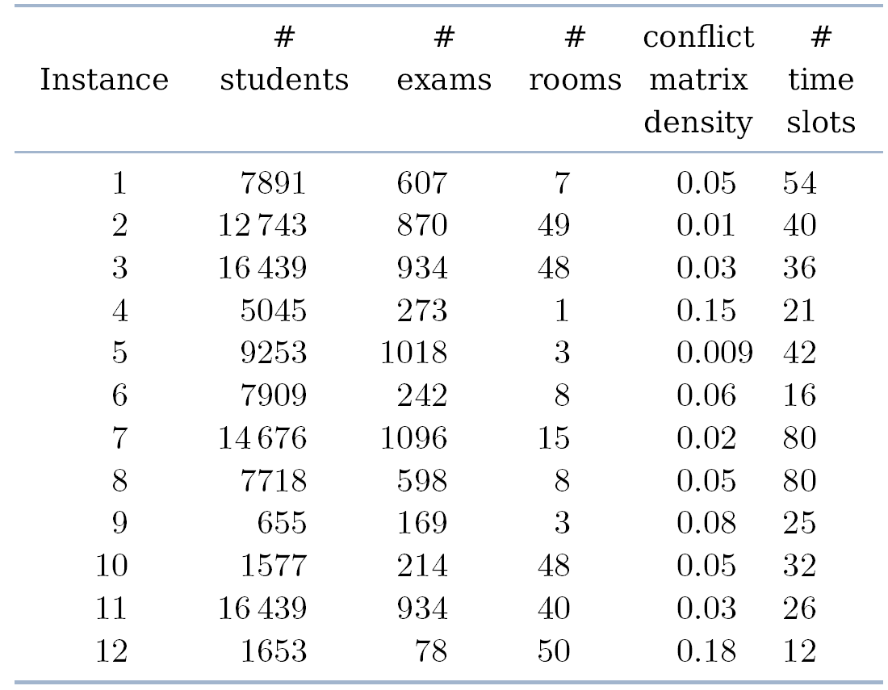
Loader

Slide 22
Graph Coloring
The method used is the Largest Degree Ordering method;
The heuristic used to generate a feasible solution;
The implementation was divided in four phases:
Adds the exclusion hard constraints to the conflict matrix;
Erases all examination coincidence hard constraints’ occurrences that have student conflicts;
Populates and sort the assignment lists:
Unassigned examinations with room exclusivity hard constraint;
Unassigned examinations with after hard constraint;
Unassigned examinations with examination coincidence hard constraint;
All other unassigned examinations.
Examination assignment.
Normal assignment;
Forcing assignment.

Slide 23
Proposed Approach: Local Search
Used to improve the solution obtained using the GC heuristic;
Used local search meta-heuristics:
Simulated Annealing;
Hill Climbing.

Slide 24

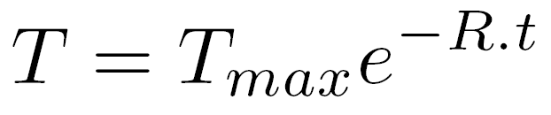
Simulated Annealing
Meta-heuristic used to optimize the solution given by the GC heuristic;
Generates neighbor solutions by applying neighbor operators;
Neighbor solutions are accepted using an acceptance criterion:
The current solution uses an exponential (decreasing) cooling schedule:
Parameters used in this meta-heuristic:
Maximum temperature;
Minimum temperature;
Number of iterations per temperature value;
Temperature decreasing rate;

Slide 25
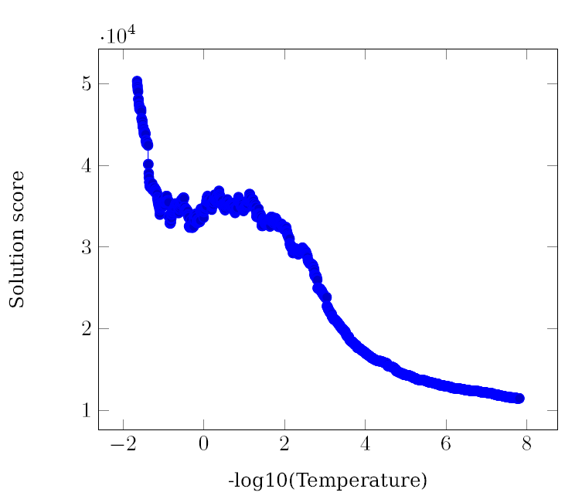
Simulated Annealing
Parameters : TMax = 45, TMin = e⁻¹⁸, loops = 5 and rate = 0.01
Results:

Slide 26
Hill Climbing
Last meta-heuristic used in the project, after SA;
Uses the same neighbor operators as the SA;
Only accepts better solutions;
It is time-monitored;
Used to guarantee that the project is finished within the given time limit (total of 225 seconds);

Slide 27
Neighborhood Operators
The neighborhood operators are randomly chosen to be used:
Room Change;
Period Change;
Period & Room Change;
Room Swap;
Period Swap;
Period & Room Swap.

Slide 28
Experimental Results
The results were obtained by averaging the 10 runs for each dataset;
The parameters used to run the SA were:
TMax = 0.01
TMin = 1e⁻¹⁸
reps = 5
rate = 0.001

Slide 29
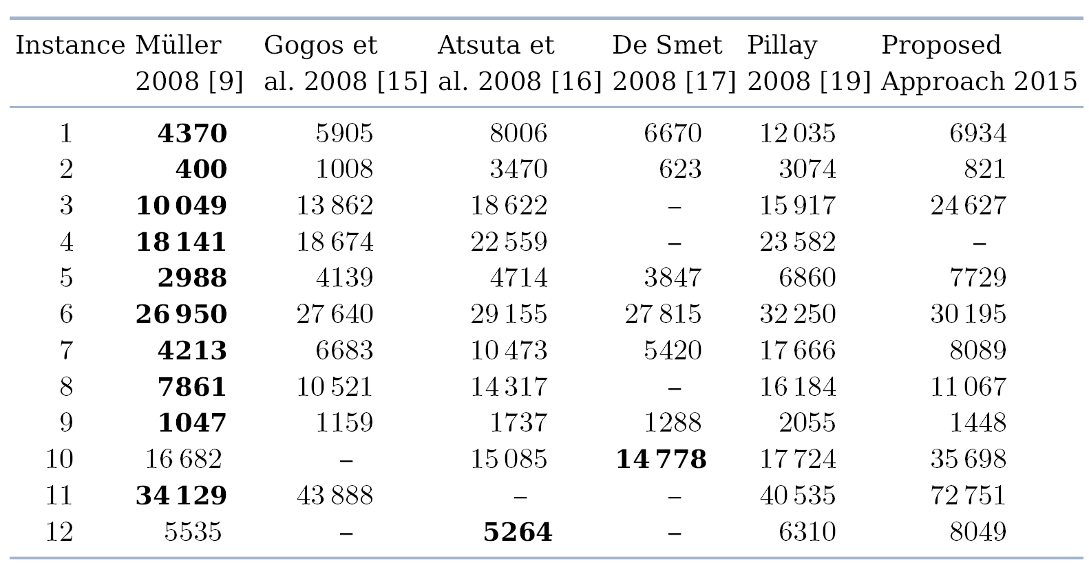
Experimental Results

Slide 30
The End
I hope you enjoyed it!

